Slide 1
🏆 Let’s Take Attendance🏆
http://sciovirtual.org/attendance
Attendance code: skull23

Slide 2
ScioCamp 2022: Anatomy and Physiology
Google Classroom code: sfts5re

Slide 3
Instructor Introductions
Megan Kwok
BioOlympiad UK Gold
IBO HK Team Finalist
Fun Fact: My favourite book is The Great Gatsby!
Cloris
Scioly Anatomy Silver Medalist
Fun Fact: She’s a published poet!
Tanush
Former Brain Bee competitor
USABO and Science Fair
Fun Fact: I am quite fond of kiwis and can eat up to 10 a day.
Krutharth
Addicted to Gamepigeon word games
USABO and Scioly
Coming soon (probably Friday)

Slide 4
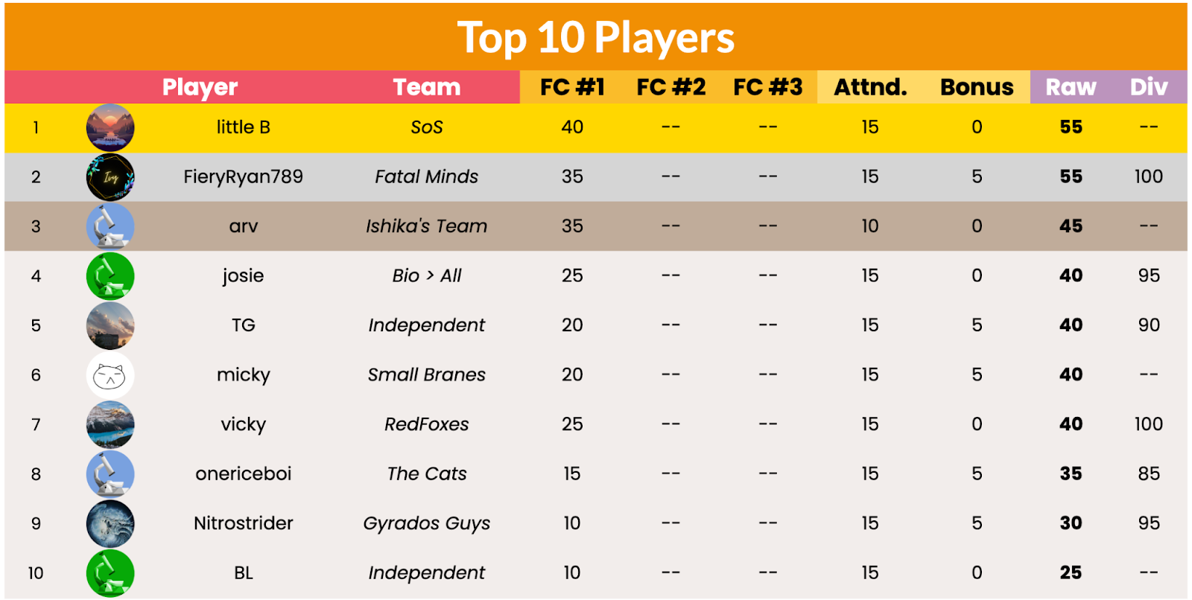
🏆 Score Points. Win Prizes.🏆
🧠 Course challenges each Friday
✅ Attendance
🗣️ Active participation with video on
Note: Class scores are added to your team score (if you are in the team competition)c
More info at sciovirtual.org/score

Slide 5
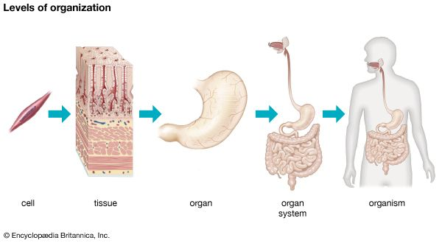
Organization of the Body
Cells are the smallest living unit of life
A tissue is a group of like cells working together.
An organ is a structure composed of several different tissues performing a
particular function.
Organ systems are groups of organs which together perform an overall function.
The total organism is the individual human being.

Slide 6
Let’s Start with a Quick Quiz so we know how far you’ve all learned (about the digestive and respiratory systems) in school! Don’t worry about getting things wrong.

Slide 7
Digestive System
What do you know about nutrition?

Slide 8
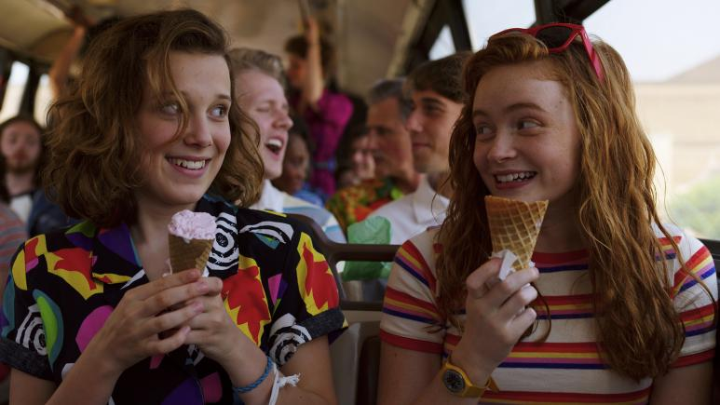
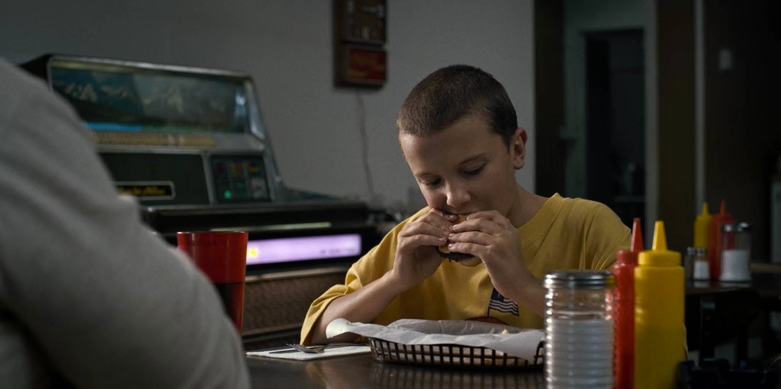
What is Digestion
Humans need to break down ingested food into small particles to synthesize new particles for specific use for the organisms ingesting the material
Amino acids, monosaccharides, nitrogenous bases, sugars, phosphates, glycerol, fatty acids and monoglycerides
What do you think each of these particles make?
E.g. Amino acids make up proteins!

Slide 9
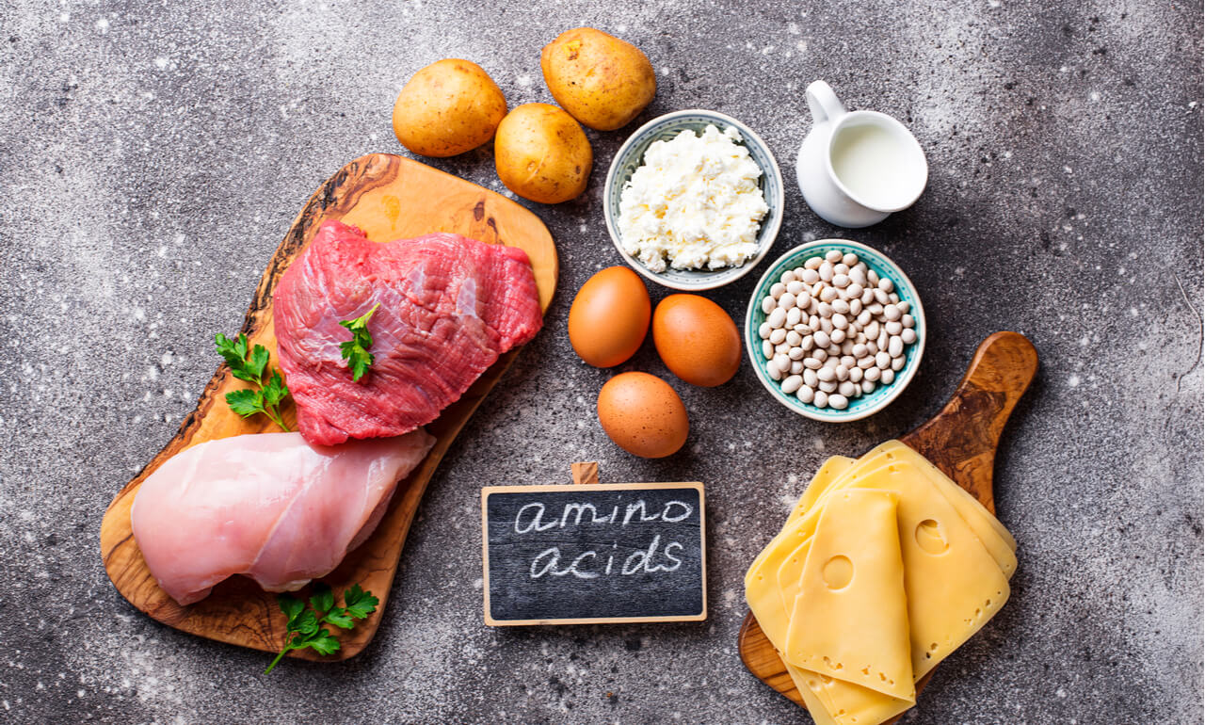
Types of Essential Nutrients
Amino acids
Fatty acids
Vitamins
Minerals
Carbohydrates
Which foods are each of these nutrients found in?

Slide 10
What happens when you don’t take in the right amount of nutrients?

Slide 11
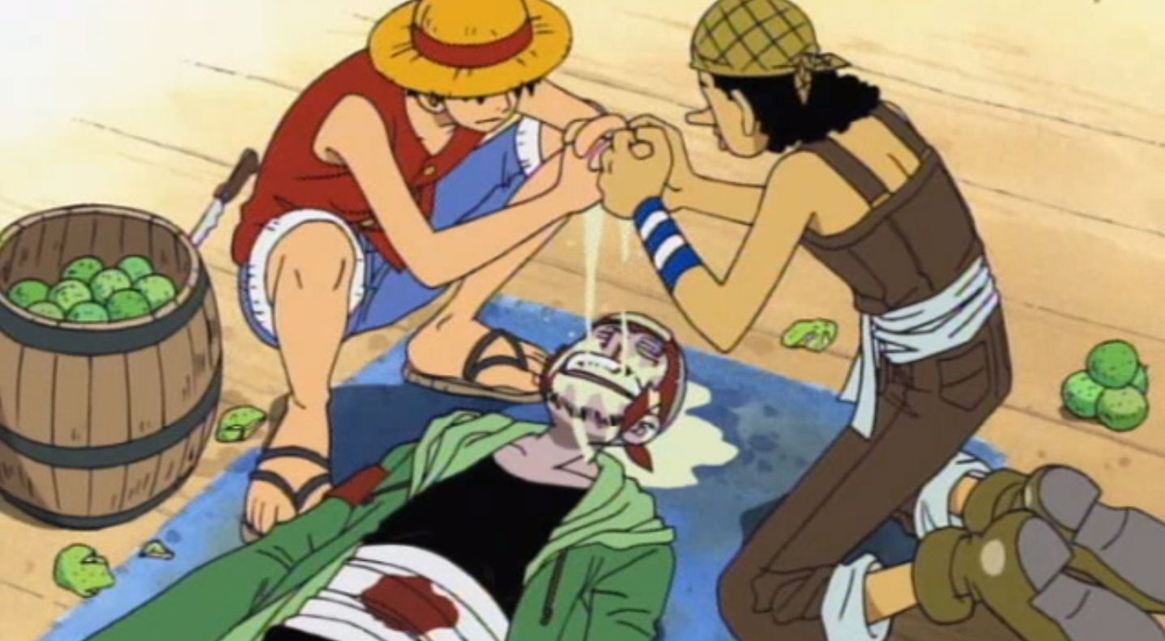
Scurvy
Vitamin C deficiency
Pale skin, sunken eyes, loss of teeth
Easily treated by eating certain fruits and veggies
Q: Can you guess why this picture is used? ->

Slide 12
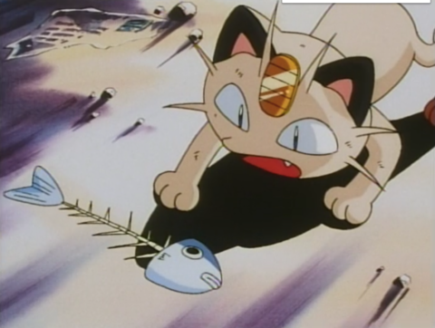
Rickets
Vitamin D deficiency
In children; affects bone development leading to deformities
Eggs, meat, oily fish

Slide 13
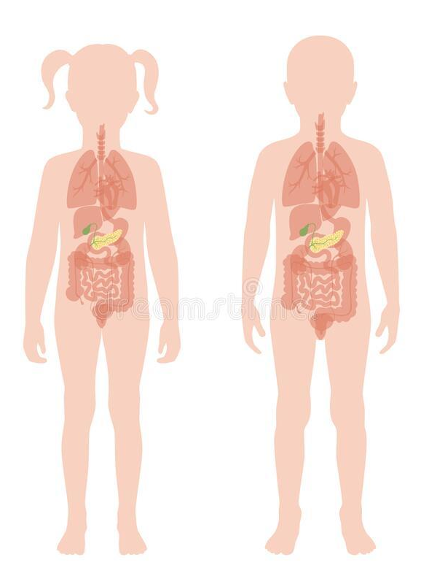
The Digestive/GI Tract
2. Name one organ in the digestive tract!

Slide 14
Mouth
Here the digestion of food starts
The teeth chomp, chew, and tear food down into smaller pieces (mechanical digestion); molecular structure of the food
Salivary glands secrete saliva into the mouth, breaking down starches into dextrin and maltose (chemical digestion). changes the molecular structure of the food.
Create food boluses.
Then they go down the pharynx, preventing food from going to windpipe/trachea(path to lungs)

Slide 15
Oesophagus
After the pharynx, food bolus is transported to the stomach via the esophagus/oesophagus.
A muscle-walled tube that goes from the throat to the lower digestive tract.
Muscular contractions (peristalsis) push food down towards the stomach.
The reason peristalsis is important is when digestion is working against gravity. For example, when eating upside down, the food bolus is still able to move to the stomach because of peristalsis contractions.

Slide 16
Stomach
When we think of digestion, the first thing that comes to mind is the stomach.
Waiting room for food bolus.
Stomach breaks the food down into a liquid-like mixture by churning the food (mechanical digestion) and secreting gastric acid (chemical digestion).
Gastric acid also kills bacteria that may be in the food.

Slide 17
Duodenum (In the small intestine)
Transfer to the duodenum by contractions of the stomach walls.
First part of the small intestine; stationary and is fixed behind sheets of connective tissue called peritoneum.
Glands in the duodenum secrete a thick alkaline fluid that neutralises the acidic chemicals the food bile has absorbed.
Gallbladder also secretes pancreatic juice and bile into the duodenum.

Slide 18
Liver
Very important though food does not directly pass through
Produces bile (a greenish fluid which aids in the digestion of fats), which is stored in the gallbladder.
Joins with secretions from the pancreas and goes through the common bile duct into the duodenum.

Slide 19
Jejunum + Ileum (In the small intestine)
After the duodenum comes the jejunum and the ileum.
Make up the bulk of the small intestine.
The jejunum comes first.
Food boluses are digested even further, and some nutrients are absorbed through the walls.
Ileum is the longest portion of the small intestine.

Slide 20
Large Intestine
After passing through the small intestine, food bolus makes its way through the large intestine.
Shorter than the small intestine, but larger in diameter
Water and electrolytes are removed in the large intestine.
Microbes such as bacteria aid in further digestion.
Finally, food bolus comes out of the anus as feces.

Slide 21
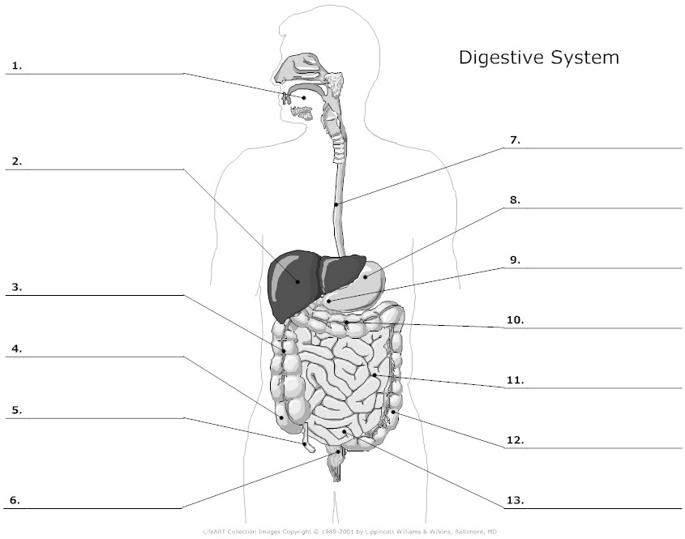

Slide 22
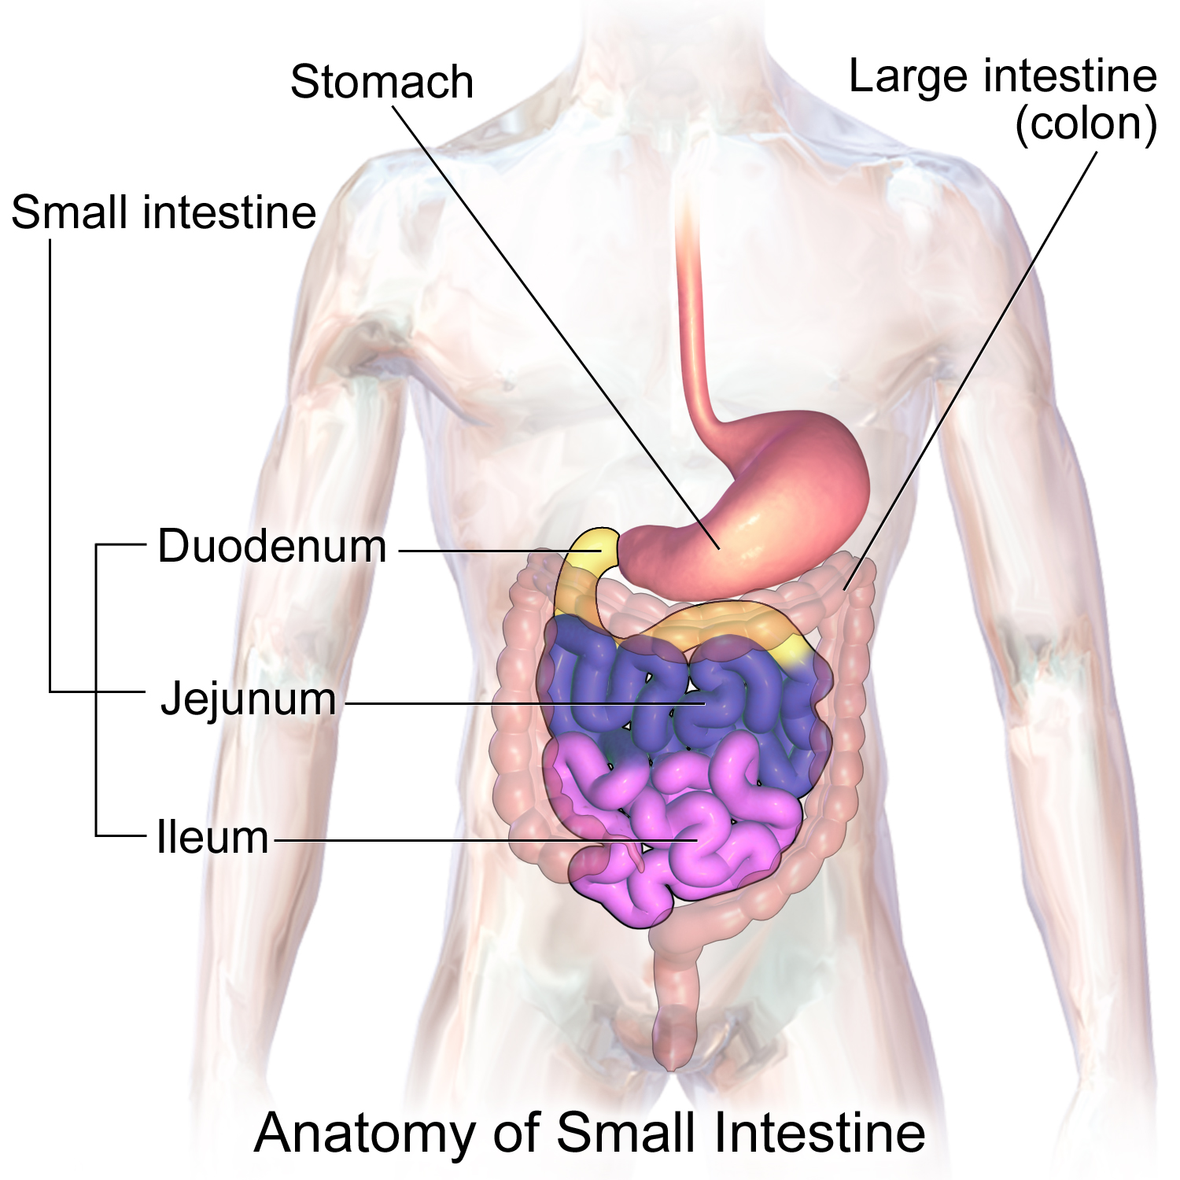

Slide 23
What About Animals?

Slide 24
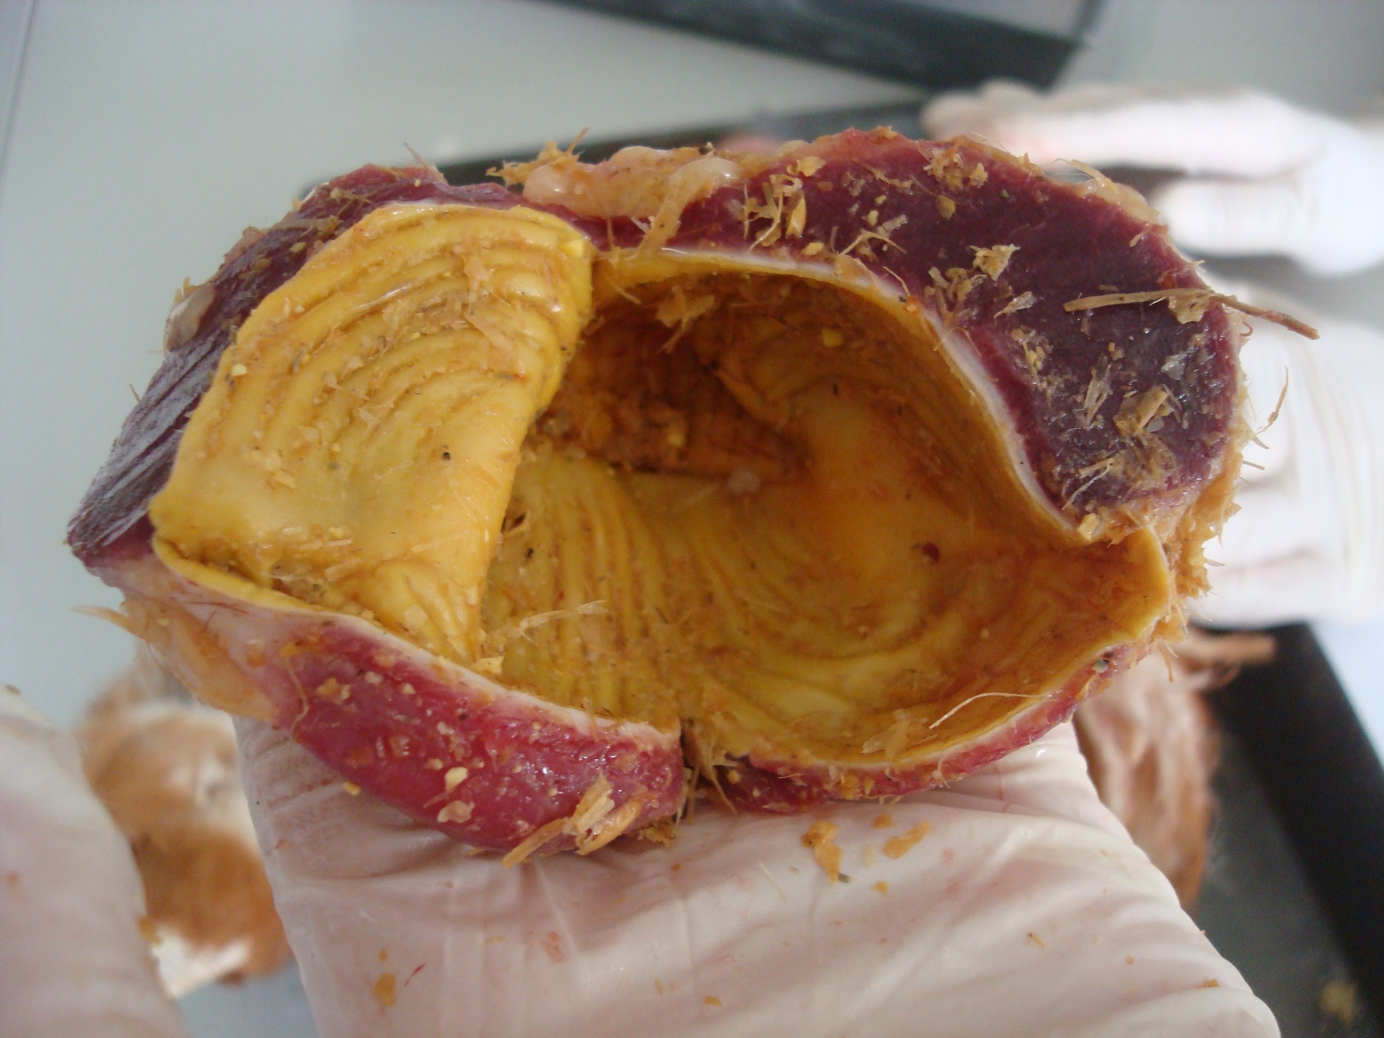
Gizzard
Many birds, reptiles and fish have gizzards
Why chickens do not need teeth.
Muscular part of the stomach
Chickens use grit (small, hard particles of pebbles or sand) to grind grains and fiber into smaller, more digestible, particles.

Slide 25
Crops
Many birds, invertebrates, gastropods, earthworms, leeches and insects
Like a “doggy bag” when the animal eats.
Many animals eat as much as possible when the opportunity for feeding presents itself.
Food can’t be digested this quick.
Crop enables the animal to fill up and then the animal can do the digesting later

Slide 26
Intracellular and extracellular digestion
Breakdown of food materials occurs inside the food vacuoles.
Ingestion occurs through the phagocytic vesicles.
Enzymes involved: lysozyme
Only chemical digestion
Nutrients diffuse into the cytoplasm through the membrane of vacuole
The materials that are not digestible get excreted through the exocytosis.
Simple mechanism; involves vesicles.
Mainly occurs in protozoans.
Breakdown of food materials occurs outside the cell in the lumen of the alimentary canal or on the decaying organic materials.
Ingestion occurs through the mouth.
Enzymes secreted from the glands of the alimentary canal.
Both chemical and mechanical digestion occurs.
Nutrients absorbed into the blood through the gut epithelia.
The materials that are not digestible get excreted through the anus.
Complex mechanism; involves the organs and glands.
It follows in bacteria, fungi, and animals with the alimentary canal

Slide 27
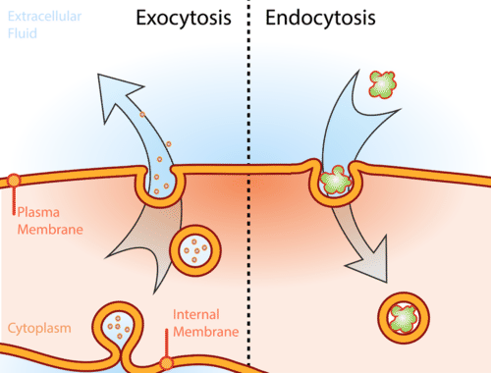

Slide 28
Gastrovascular Cavity
Primary organ of digestion and circulation in two major animal phyla: Coelenterates and Platyhelminthes
An open space inside the animal surrounded by endodermal tissue; intracellular digestion.
Food passes through the opening, or mouth, and enters the cavity.
Some endodermal cells secrete enzymes
Small digested particles taken up by other endodermal cells
Waste particles expelled from cavity

Slide 29
Any Questions?

Slide 30
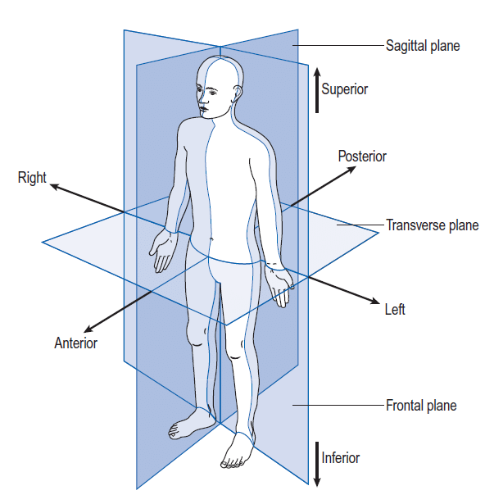
Anatomical Directions
Standard anatomical position
standing up, palms and feet facing forward
Standard terms
Anatomical regions
Ex. bucca (cheek), patellar (kneecap), lumbus (lower back)

Slide 31
Characteristics of Animals (Humans Included)
Motility
Exchange w/ environment
Advanced Nervous system (with sensory organs)
Heterotrophs
Internal digestion
Muscular
Respiratory
Nervous
Digestive
Digestive

Slide 32
Pharynx
A shared connection between the nasal cavities, the mouth, the air tract, and the esophagus.
Structure to prevent the boluses from entering the trachea (passage to the lungs). This is why we have an epiglottis. (a small flap which can open and close the entrance to the trachea).
When food boluses travel through the pharynx, the epiglottis folds down to protect the airway.
However, in instances such as talking or eating, the epiglottis can get confused.

Slide 33
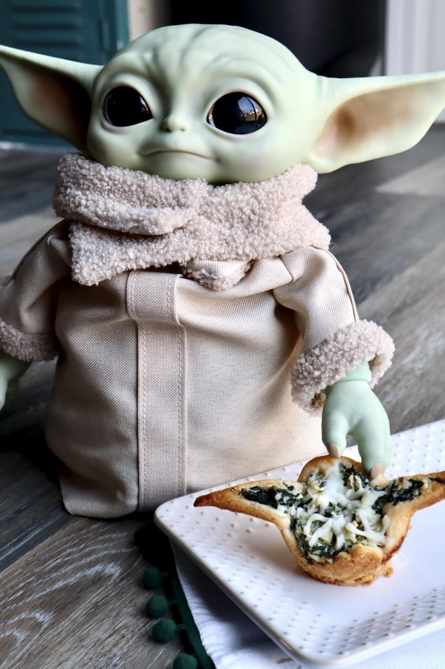
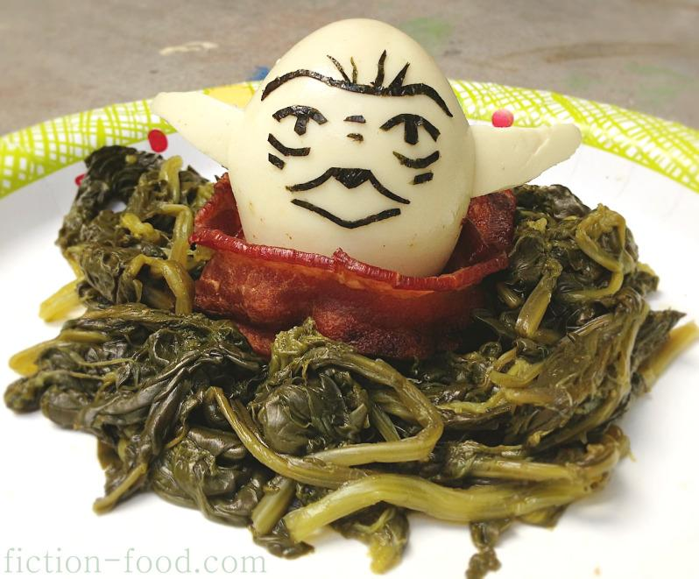
Anaemia
Vitamin B12/Iron deficiency
Body lacks iron in red blood cells
Tiredness, lack of energy, shortness of breath, pale skin
Q: Can you guess which foods can reduce the chances of getting anaemia?

Slide 34
Chickens’ Digestive System
CHICKENS DON’T HAVE TEETH
Food is taken in with the beak; Saliva and enzymes are added as the food moves from the mouth into the esophagus.
From the esophagus food moves to the crop (storage compartment)
Food trickles from the crop into the bird’s stomach (gizzard) where digestive enzymes are added to the mix and physical grinding of the food occurs.

Slide 35
Chicken Digestive System (Cont’d)
From the gizzard, food passes into the small intestine.
Residue then passes through the ceca, a blind sack along the lower intestinal tract, where bacteria help break down undigested food. From the ceca, food moves to the large intestine (same function as humans’ large intestine).
Remaining residue passes through the cloaca where the chicken’s urine (the white in chicken droppings) mixes with the waste. Both exit the chicken at the vent, the external opening of the cloaca.

Slide 36
Bird Digestive System
Bill: scooping, pecking, tearing and generally picking up the bird’s food.
Tongue: direct the food item down the digestive tract and sometimes to help hold onto a wiggling worm or other insect.
Pharynx is the part between the mouth and esophagus that helps the bird swallow the food item.
Esophagus

Slide 37
Birds Digestive System (Cont’d)
Proventriculus: first part of the bird’s two-chambered stomach; secretes an acid used for breaking down food; best developed in birds that swallow entire fish or other animals containing bones
Gizzard: second chamber of the stomach; consists of very tough muscles that grind and digest various types of foods.

Slide 38
Birds Digestive System (Cont’d)
Intestines: nutrients absorbed, waste products sent further on through the digestive system.
Caeca, plural for caecum, because birds usually have two of them.
Aid in the absorption of water and proteins, and the microbial decomposition of fiber.
Rectum: end part of the intestine
Cloaca: waste from the digestive and urinary tract accumulate before being dumped.

Slide 39
Cow Digestive System (Ruminant Digestive System)
Stomach has four compartments:
Rumen
Reticulum
Omasum
Abomasum.
In calves, the esophageal grooves allows milk to bypass the rumen and directly enter the abomasum. Rumen development occurs following a change in diet and microbial growth.

Slide 40
Rumen
On the left side of the animal, largest stomach compartment, consists of several sacs
Storage or holding vat for feed Fermentation vat (growth of microbes which digest or ferment feed within the rumen and make volatile fatty acids (VFAs))
A good blood supply to the rumen walls improves absorption of VFAs and other digestion products. Tiny projections (papillae) line the rumen, which increases the rumen’s surface area and the amount it can absorb.

Slide 41
Reticulum
Pouch-like structure in the forward area of the body, close to the heart. The tissues in the reticulum form a network similar to a honeycomb. A small tissue fold lies between the reticulum and rumen (rumino-reticulum)
Heavy or dense feed and metal objects eaten by the cow drop into here. Nails and other sharp objects may work into the tissue and cause “hardware disease.” (Magnets to treat)

Slide 42
Omasum
Globe-shaped structure containing leaves of tissue (like pages in a book).
Absorbs water and other substances from digestive contents.
Feed material (ingesta) between the leaves will be drier than ingesta found in the other compartments.

Slide 43
Abomasum
The only compartment lined with glands.
Release hydrochloric acid and digestive enzymes, needed to breakdown feeds
Similar to a non-ruminant stomach.

Slide 44
Global Warming?
Digestion produces 30 to 50 quarts of gas per hour in the rumen. Carbon dioxide and methane are the main gases present. Cows must release this gas to avoid bloating. Under normal conditions, swelling from gas formation causes the cow to belch and release the gas.

Slide 45
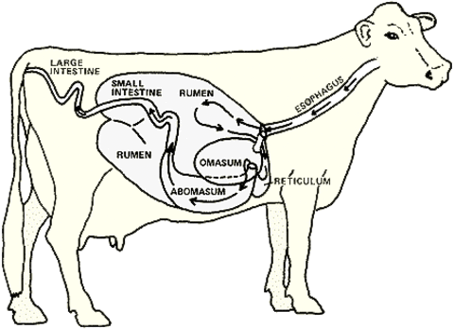

Slide 46
Feeding Mechanisms
Substrate feeding: a feeding mechanism in which the organism lives in/on its food source and eats through it
Ex: caterpillar
Filter feeding: organism filters out nutrients using currents of water
Ex: whales, clams, some types of fish
Fluid feeding: organism feeds on the fluids of other organisms
Ex: mosquitoes, hummingbirds

Slide 47
Feeding Mechanisms (Continued)
Bulk feeding: the organism consumes large pieces if not all of its prey
Ex: lions, snakes

